Slide 1
Computer Science

Slide 2
Computer
A computer is an electronic device, operating under the control of instructions stored in its own memory that can accept data (input), process the data according to specified rules, produce information (output), and store the information for future use

Slide 3
Functionalities of a computer
Any digital computer carries out five functions in gross terms:
• Takes data as input.
• Stores the data/instructions in its memory and use them when required.
• Processes the data and converts it into useful information.
• Generates the output
• Controls all the above four steps

Slide 4

Functionalities of a computer(Contd.)
Processing
Data
Information

Slide 5
Computer Components
Hardware
Software

Slide 6
Hardware
Computer hardware is the collection of physical elements”Tangible objects”
that constitutes a computer system.
The actual machinery, wires, transistors, and circuits … etc.

Slide 7
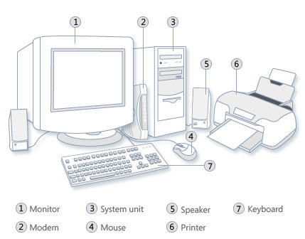
Hardware:

Slide 8
Software
Computer Programs
instructions and data

Slide 9
Computer Units
Input Unit
Central processing Unit
Primary Memory Unit
Secondary storage Unit
Output Unit

Slide 10
Input Devices
Input device is any peripheral (piece of computer hardware equipment to provide data and control signals to an information processing system such as a computer or other information appliance.
Input device Translate data from form that humans understand to one that the computer can work with. Most common are keyboard and mouse

Slide 11
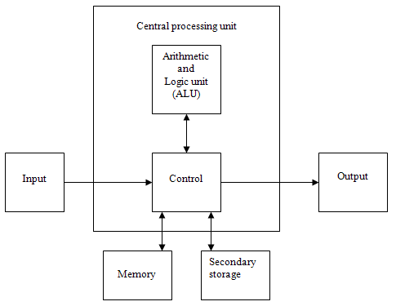
Computer Units

Slide 12
Input Devices

Slide 13
Example of Input Devices
Keyboard | Mouse (pointing device) | Microphone
Touch screen | Scanner | Webcam
Touchpads | MIDI keyboard
Graphics Tablets | Cameras | Pen Input
Video Capture Hardware | Microphone | Trackballs
Barcode reader | Digital camera | Joystick
Gamepad | Electronic Whiteboard
Note: The most common use keyboard is the QWERTY keyboard. Generally standard Keyboard has 104 keys

Slide 14
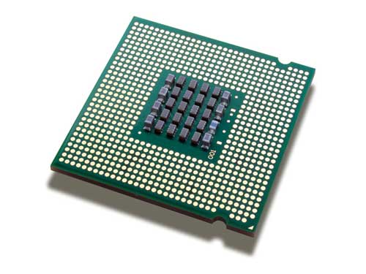
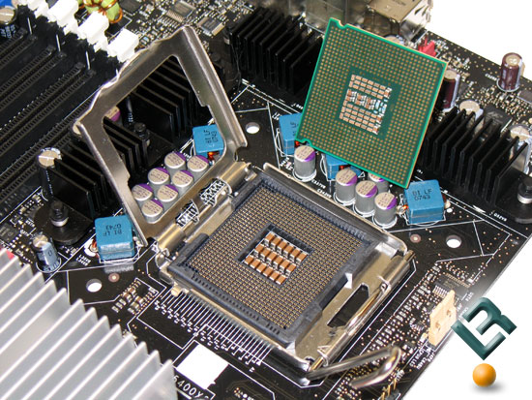
Central Processing Unit
CPU
known as microprocessor or processor
It is responsible for all functions and processes

Slide 15
CPU Components
The CPU is comprised of three main parts
ALU (Arithmetic Logic Unit)
Control Unit (CU)
Registers: Stores the data that is to be executed next.

Slide 16
ALU
Executes all arithmetic and logical operations.
Arithmetic calculations like as addition, subtraction, multiplication and division.
Logical operation like compare numbers, letters, or special characters

Slide 17
Control Unit (CU)
Control Unit (CU): controls and co-ordinates computer components.
Read the code for the next instruction to be executed.
Increment the program counter so it points to the next instruction.
Read whatever data the instruction requires from cells in memory.
Provide the necessary data to an ALU or register.
If the instruction requires an ALU or specialized hardware to complete, instruct the hardware to perform the requested operation.

Slide 18
Registers
Registers: Stores the data that is to be executed next, "very fast storage area".

Slide 19
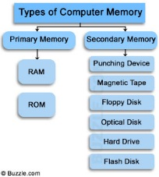
Primary Memory
1. RAM.
2.ROM

Slide 20
Primary Memory
1. RAM: Random Access Memory: is a memory scheme within the computer system responsible for storing data on a temporary basis, so that it can be promptly accessed by the processor as and when needed.
It is volatile in nature, which means that data will be erased once supply to the storage device is turned off.
RAM stores data randomly and the processor accesses these data randomly from the RAM storage.
RAM is considered "random access" because you can access any memory cell directly if you know the row and column that intersect at that cell.

Slide 21
Primary Memory
2. ROM (Read Only Memory): ROM is a permanent form of storage. ROM stays active regardless of whether power supply to it is turned on or off. ROM devices do not allow data stored on them to be modified.

Slide 22
Secondary Memory
Stores data and programs permanently
its retained after the power is turned off
Main Examples
  Hard Disk
  Optical Disk
  Flash memory

Slide 23
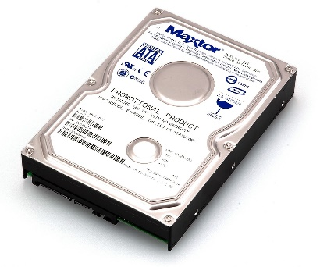
Hard Disk
Called Disk drive or HDD
stores and provides relatively quick access to large amounts of data.
Stores data on an electromagnetically charged surface or set of surfaces.

Slide 24
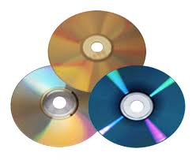
Optical Disk & Flash
an optical disc drive (ODD) is a disk drive that uses laser light to store data.
There are three main types of optical media: CD, DVD, and Blu-ray disc
CD “Compact Disk” can store up to 700MB
DVD “ Digital Video Disk “ can store up to 8.4 GB
Blu-ray disc. can store up to 50 GB

Slide 25
3. Flash Disk
A storage module made of flash memory chips. A Flash disks have no mechanical platters or access arms, but the term "disk" is used because the data are accessed as if they were on a hard drive. The disk storage structure is emulated.

Slide 26
RAM V.s Hard Disk
What are the differences between RAM as a main memory and HDD as a Secondary Memory.

Slide 27
RAM V.s Hard Disk

Slide 28
Output Unit
An output device is any piece of computer hardware equipment used to communicate the results of data processing carried out by an information processing system (such as a computer)
converts the electronically generated information into human-readable form.

Slide 29
Output devices Examples
Monitor | LCD Projection Panels
Printers (all types) | Computer Output Microfilm (COM)
Plotters | Speaker(s)
Projector

Slide 30
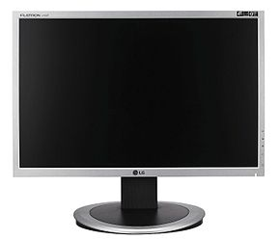
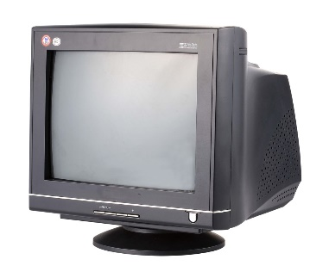
Output devices Examples
A monitor
LCD: Liquid crystal display most familiar these days
CRT: Cathode Ray Tube

Slide 31
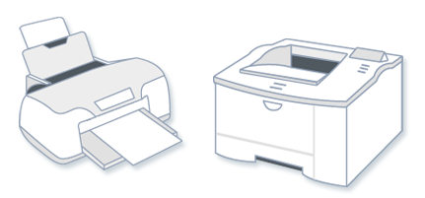
Output devices Examples
2. Printer:
transfers data from a computer onto paper
Printer types:
1-Laser Printer.
2-Ink Jet Printer.
3-Dot Matrix Printer

Slide 32
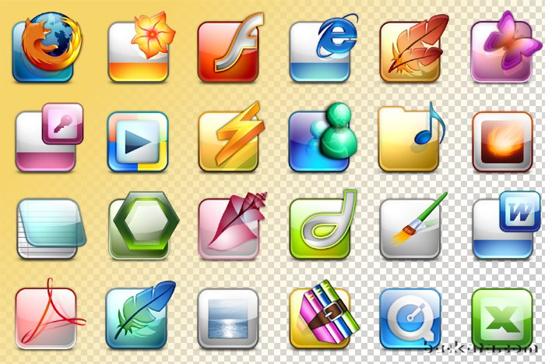
Software
Software is a generic term for organized collections of computer data and instructions, often broken into two major categories two major categories:
  system software
  application software

Slide 33
System software
Known as Operating System
is responsible for controlling, integrating, and managing the individual hardware components of a computer system
Windows is an example of OS.
example of System Software:
1) Microsoft Windows
2) Linux
3) Unix
4) Mac OSX
5) DOS

Slide 34
Application software
is used to accomplish specific tasks other than just running the computer system.
It may consist of:
  a single program, such as an image viewer;
  a small collection of programs (often called a software package) that work closely together to accomplish a task, such as a spreadsheet or text processing system;
  a larger collection (often called a software suite) of related but independent programs and packages that have a common user interface or shared data format, such as Microsoft Office,

Slide 35
Unit of Measurements - Storage
Storage Units
Bit | BIT | 0 or 1
Byte | B | 8 bits
Kilobyte | KB | 1024 bytes
Megabyte | MB | 1024 kilobytes
Gigabyte | GB | 1024 megabytes
Terabyte | TB | 1024 gigabytes

Slide 36
Size example
• 1 bit - answer to an yes/no question
• 1 byte - a number from 0 to 255.
• 90 bytes: enough to store a typical line of text from a book.
• 4 KB: about one page of text.
• 120 KB: the text of a typical pocket book
• 3 MB - a three minute song (128k bitrate)
• 650-900 MB - an CD-ROM
• 1 GB -114 minutes of uncompressed CD-quality audio at 1.4 Mbit/s
• 8 -16 GB - size of a normal flash drive

Slide 37
A. 10B is equivalent 10 * 8 = 80 bits
B. 3MB is equivalent to how many Bits?
Answer:
• 3 *1024 = 3072 KB
• 3072*1024 = 3145728 B
• 3145728 * 8 = 25165824 bits

Slide 38
Unit of Measurement -Speed
The speed of CPU measured by unit called Hertz (Hz)
1 Hz represent 1 cycle per second.
The speed of CPU is known as Computer Speed.

Slide 39
Unit of Measurement -Speed
CPU SPEED MEASURES
1 hertz or Hz | 1 cycle per second
1 MHz | 1 million cycles per second or 1000 Hz
1 GHz | 1 billion cycles per second or 1000 MHz

Slide 40
Computer Classification
Computers can be classified by size and power to:
  Personal computer (PCs)
  Workstation:
  Minicomputer
  Mainframe:
  SuperComputer

Slide 41
Computer Classification
Personal computer (PCs): a small, single-user computer based on a microprocessor. In addition to the microprocessor, a personal computer has a keyboard for entering data, a monitor for displaying information, and a storage device for saving data.
Workstation: a powerful, single-user computer. A workstation is like a personal computer, but it has a more powerful microprocessor and a higher-quality monitor.

Slide 42
Computer Classification
Minicomputer: multi-user computer capable of supporting from 10 to hundreds of users simultaneously.
Mainframe: powerful multi-user computer capable of supporting many hundreds or thousands of users simultaneously.
Supercomputer: an extremely fast computer that can perform hundreds of millions of instructions per second.

Slide 43
Computer Classification
Compare between the previous type of computers based on
    Price
    Processing Speed
    Storage Capacity
    Powerful
    Single-user or Multi-user
    Computer Size
    Companies size

Slide 44
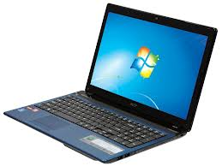
Laptop computer
is a portable computer.
personal computer that can be easily carried and used in a variety of locations.
run the same software and applications in PCs

Slide 45
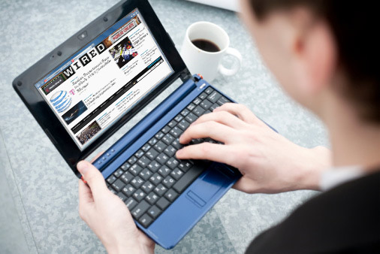
Netbook Computer
A netbook is a type of laptop that is designed to be even more portable.
Cheaper and less powerful than laptops or desktops.
They are generally less powerful than other types of computers, but they provide enough power for email and internet access, which is where the name "netbook" comes from.

Slide 46
Mobile Devices
A mobile device is basically any handheld computer.
It is designed to be extremely portable.
Some mobile devices are more powerful
Types:
    Tablet Computers
    Smartphones

Slide 47
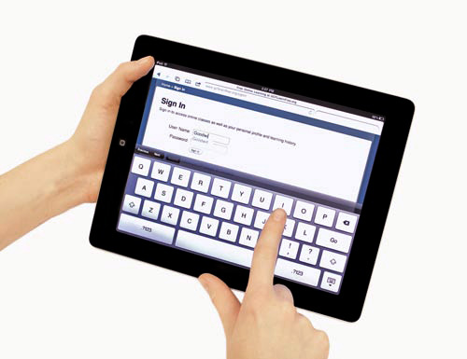
Tablet Computers
designed to be portable.
The most obvious difference is that tablet computers don't have keyboards or touchpads.
Best used for tasks like web browsing, watching videos, reading e-books, and playing games.

Slide 48
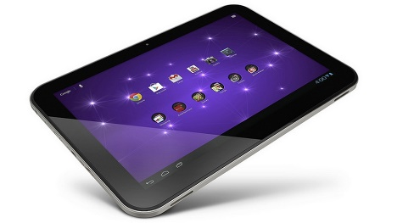
Tablet Computers
The most obvious difference is that tablet computers don't have keyboards or touchpads. Instead, the entire screen is touch-sensitive, allowing you to type on a virtual keyboard and use your finger as a mouse pointer.
Tablet computers are mostly designed for consuming media, and they are optimized for tasks like web browsing, watching videos, reading e-books, and playing games

Slide 49
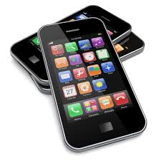
Smartphones
a powerful mobile phone
designed to run a variety of applications in addition to phone service.
Compare it with the tablet?
Internet access is an important feature of smartphones. (3G or 4G)(Wi-Fi Service)

Slide 50
Data, Information and Knowledge
Data:
  Facts and figures which relay something specific
  but which are not organized in any way and which provide no further information regarding patterns
  unstructured facts and figures

Slide 51
Data, Information and Knowledge
Information:
  For data to become information, it must be contextualized, categorized, calculated and condensed. (Processing)
  it is data with relevance and purpose.

Slide 52
Data, Information and Knowledge
Knowledge:
  Knowledge is closely linked to doing and implies know-how and understanding.
  Processing Information

Slide 53
Data, Information and Knowledge
Data: symbols
Information: data that are processed to be useful; provides answers to "who", "what", "where", and "when" questions
Knowledge: application of data and information; answers "how" questions

Slide 54
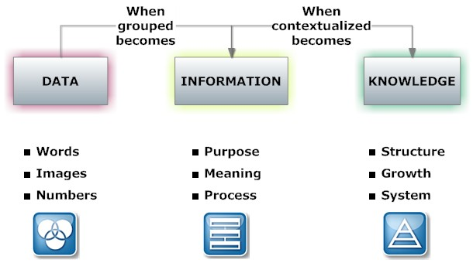
Data, Information and Knowledge

Slide 55
Data, Information and Knowledge
Processing data produces information, and processing information produces knowledge.

Slide 56
Characteristics of Computer
Speed
Accuracy
Diligence
Storage Capability
Versatility

Slide 57
Characteristics of Computer
Speed :The computer can process data very fast, at the rate of millions of instructions per second
Accuracy: Computer provides a high degree of accuracy. For example, the computer can accurately give the result of division of any two numbers up to 10 decimal places.
Diligence: When used for a longer period of time, the computer does not get tired or fatigued. It can perform long and complex calculations with the same speed and accuracy from the start till the end.
Notes:
Diligence: اجتهاد

Slide 58
Characteristics of Computer
Storage Capability: Large volumes of data and information can be stored in the computer and also retrieved whenever required. A limited amount of data can be stored, temporarily, in the primary memory. Secondary storage devices like floppy disk and compact disk can store a large amount of data permanently.
Versatility: Computer is versatile in nature. It can perform different types of tasks with the same ease. At one moment you can use the computer to prepare a letter document and in the next moment you may play music or print a document.

Slide 59
Computer Viruses
Viruses:
E-mail viruses:
Trojan horses:
Worms:

Slide 60
Viruses
  A computer virus is an application program designed and written to destroy other programs.
A virus is a small piece of software that piggybacks on real programs
virus might attach itself to a program such as a spreadsheet program
and it has the chance to reproduce (by attaching to other programs)

Slide 61
E-mail viruses:
e-mail virus travels as an attachment to e-mail messages
Replicates itself by automatically mailing itself to dozens of people in the victim's e-mail address book.

Slide 62
Trojan horses
simply a computer program
The program claims to do one thing (it may claim to be a game) but instead does damage when you run it

Slide 63
Worms
A worm is a small piece of software that uses computer networks and security holes to replicate itself.
worm scans the network for another machine that has a specific security hole.

Slide 64
Malicious Software
How do you know if you have a virus?
  Lack of storage capability
  Decrease in the speed of executing programs
  Unexpected error messages
  Halting the system

Slide 65
Tips to avoid viruses and lessen their impact?
Delete e-mails from unknown or suspicious, untrustworthy (unreliable) sources, especially those with files attached to an e-mail.
Never open a file attached to an e-mail unless you know what it is, even if it appears to come from a friend.
Download files from the Internet only from legitimate and reputable sources.
Update your antivirus software at least every two weeks as over 200 viruses are discovered each month.
Backup your files periodically

